Slide 1
Electronic structure of correlated electron systems
George Sawatzky UBC
Lecture 4 2011

Slide 2
Back to the simplest possible model for strong correlation
A Hubbard model for the hydrogen molecule

Slide 3
H2+ molecule for only 1 electron
Obviously there is no correlation
Solutions are a bonding and antibonding orbital with a separation of 2t
Things change when we go to two electrons

Slide 4
H2 model in strong correlation
One electron molecular orbital theory H atoms A and B
Splitting =2t
i.E two electrons on one site. These should be high energy states because of the coulomb interaction U . These high polarity states should be projected out for large U

Slide 5
Heitler London Model
Two hydrogen atoms each with one electron
For t=0
Triplet state
Singlet state
Now add finite t with configuration interaction (CI)

Slide 6
Heitler London limit + CI
For U>>t Singlet is lower in energy than triplet by
Low energy scale excitations are spin only excitations

Slide 7
The influence of U
As we noted before
U reduces the polarity fluctuations
U drives the system to be magnetic for open shell systems
U results in low energy scale magnetic degrees of freedom

Slide 8
The Hubbard model is not exactly solvable except in 1 D but even then the spectral functions are difficult to extract
Lieb and Wu PRL 20, 1445, (1968)

Slide 9
1D Hubbard exact and not so exact solutions
Lieb and Wu PRL 20, 1445 (1968)
For half filled s band the band gap t=1
Gutzwiller approximation ( any dimension)
Physical Review 137: A1726.
Variational wave function with weight of doubly occupied sites
decreasing as U/w increases.
η =variational parameter
v= average no of doubly occupied sites
Q(v) =band narrowing , W=2Zt; Z=nnn

Slide 10
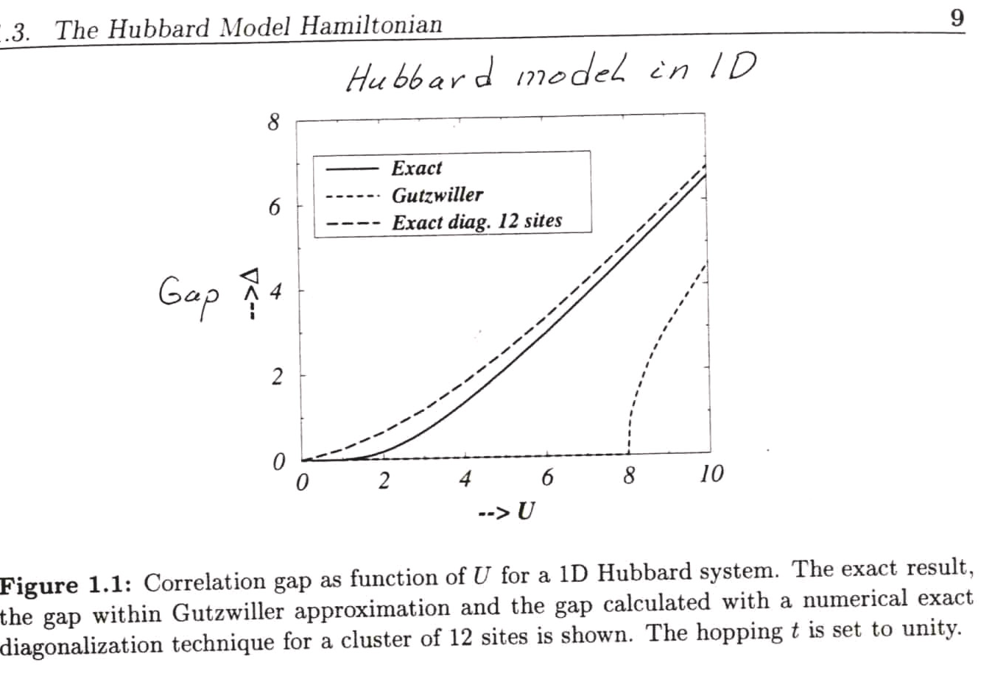
Thesis van den Brink Groningen

Slide 11
A bit more about simple models and some peculiar properties in 1 and 2 dimensions of the simple models

Slide 12
Magnetic excitations in ½ filled Hubbard or Mott insulators
Magnons and spinons in 1D Neel antiferromagnet
Magnon S=1
Two spinons each
with s=1/2
Spinons propagate via J S_{i}⁺S⁻₁₊₁
Once the spinons have moved through the central region looks like all the
spins have reversed

Slide 13
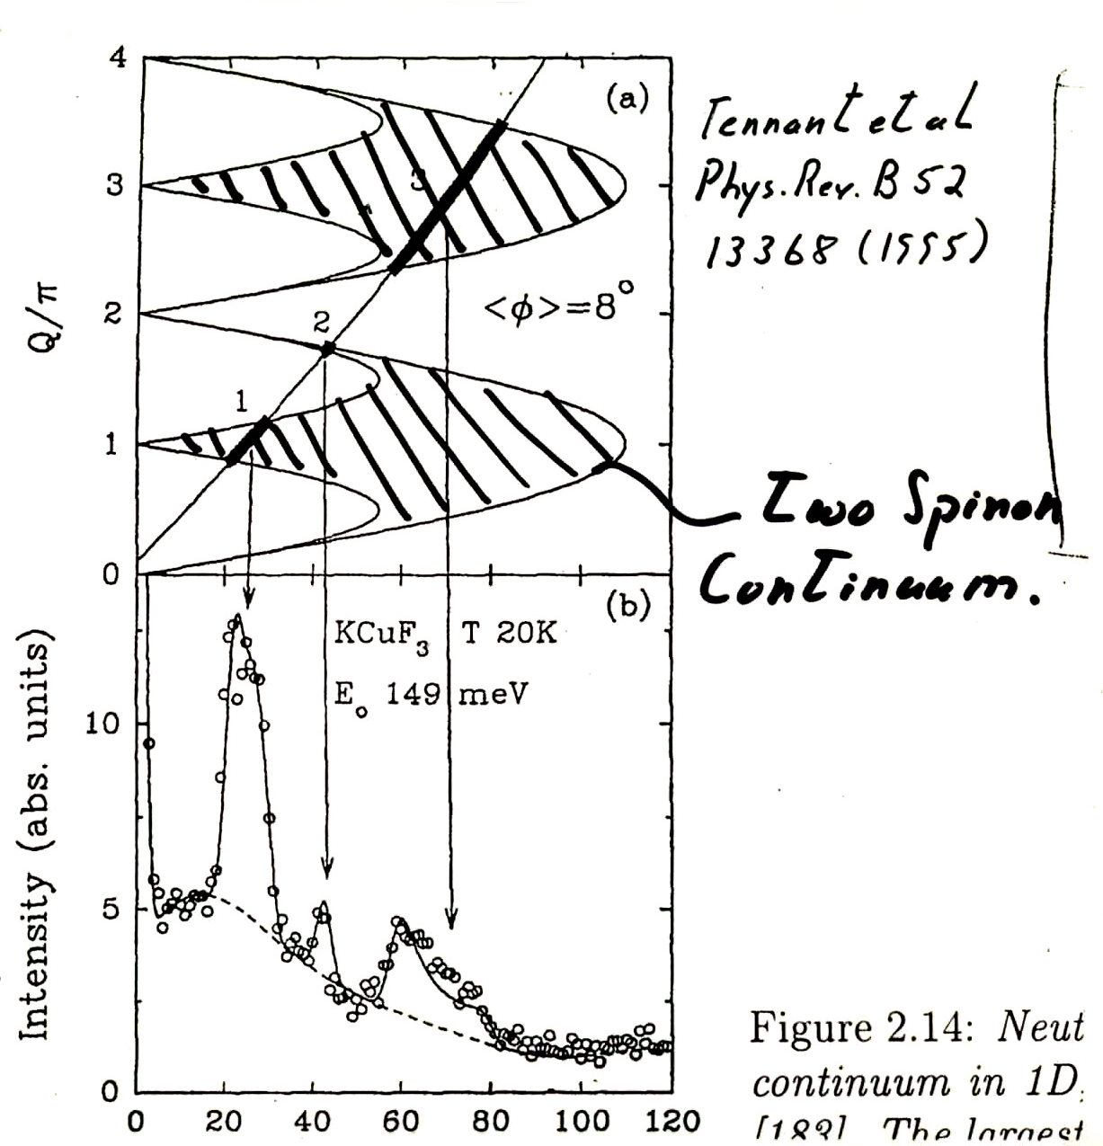
Inelastic Neutron scattering

Slide 14
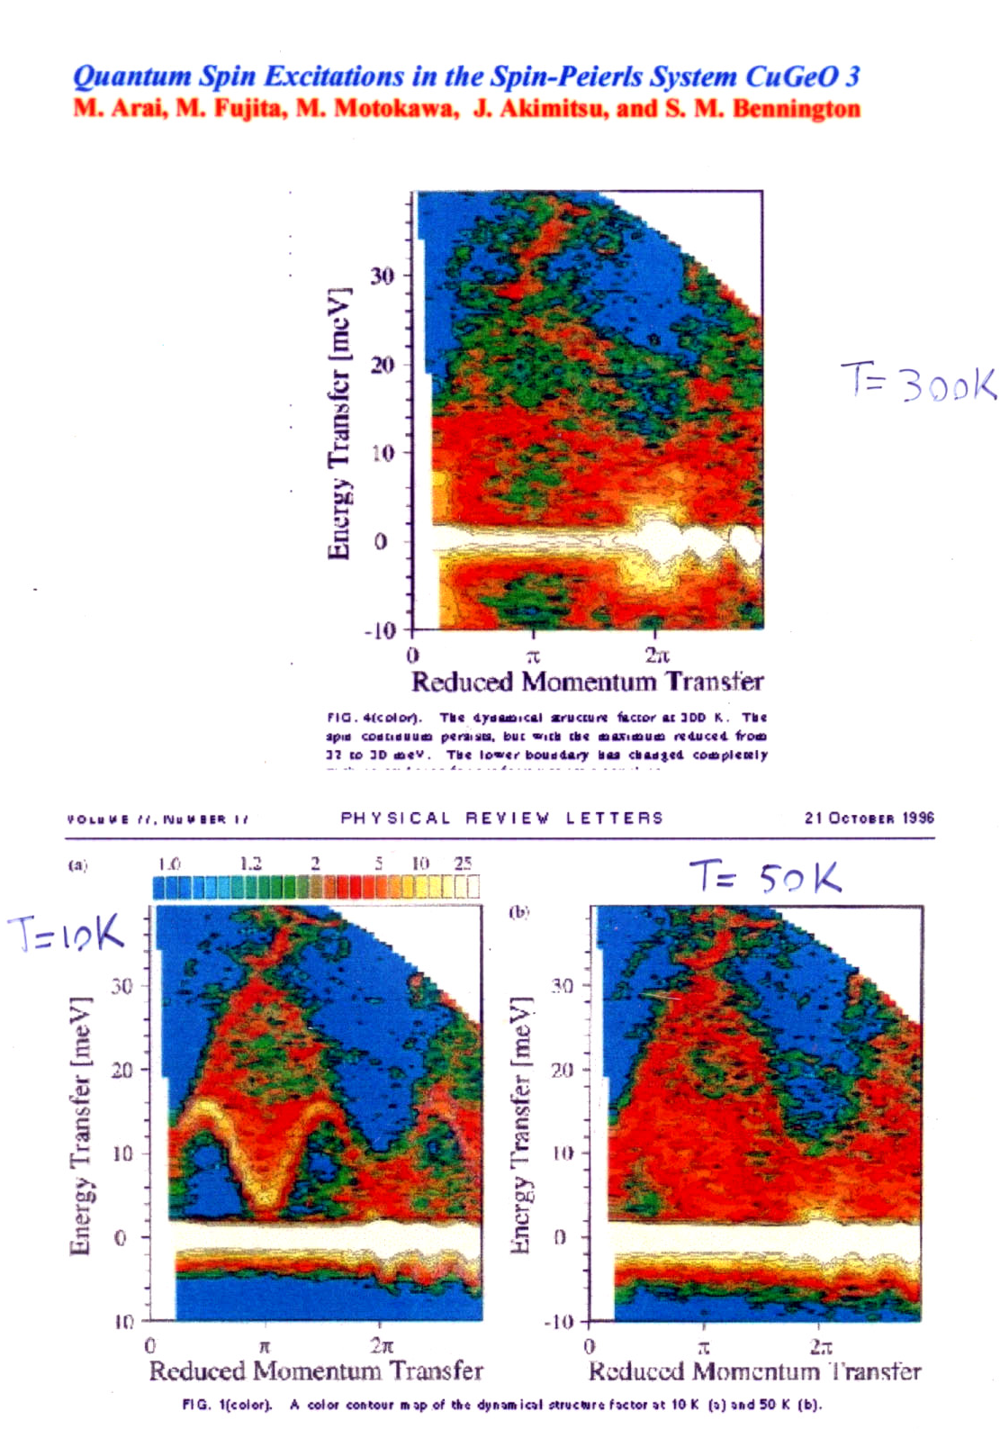

Slide 15
Heisenberg In two and three dimensions
In higher dimensions the magnetic excitations are much more like conventional magnons although a lesson also there can be learned from the 1D case.
In 1D it has been known theoretically since 1983 that the actual magnetic excitations are spinons and not magnons.
Neutron inelastic scattering also in 1D may look somewhat like magnons but it was only after one looked carefully at smaller structures and the “ background” that one could recognize the spinon character of the excitations. Tennant et al PRB532, 13358 (1995)
Although it seems difficult to define spinons in 2 and 3D there will be incoherent contributions to the magnon excitations since magnons like other quasi particles will be dressed .
Haldane PRL 50 1153 (1983) and ibid 93A, 464 1983

Slide 16
Vladimir Hinkov a Max Planck /UBC QMI visiting professor will give a lecture on Neutron scattering in March in which some of these aspects will be addressed

Slide 17
|Doped systems” i.e.Less than ½ filled Hubbard S band
t
J
Consider U>>t and the t,J model
Sums are for j a nearest neighbor to i
Avoids double
occupancy
Goes to a spin only Heisenberg Hamiltonian for half filling
Although this Hamiltonian looks plausible for U>>t I do not
know of any real proof of the transformation from Hubbard to t,J
There also is no exact solution of the tJ model
The tJ model is one of the most used models in attempts
To describe the high temperature superconducting cuprates

Slide 18
For J very small we might think of a spinless Fermion model in which a single Slater Determinant of single particle Bloch states would be eigenfunctions of H and at the same time the single particles would avoid being on the same site because they are Fermions.
In this model all signs of magnetism would disappear.
It however takes care of double occupancy and still remains otherwise single particle like.
In this Spinless Fermion model We see that each Fermion indeed blocks two states of the initial Hubbard model

Slide 19
Spin charge separation in 1D
A single electron removed from a half filled large U antiferromagnet
Hole created at site zero
Hole hops to the right via t
2nd and 3rd spin to the left exchange
Spinon moves to the left via
J S_{i}⁻S⁺_{i-1}
Spinon is gone leaving the hole at
an antiferromagnetic antiphase domain
wall and now free to move
Now the charge is free to move
so we have two free particles a
Spinon and a holon!!
Antiphase
Domain wall

Slide 20
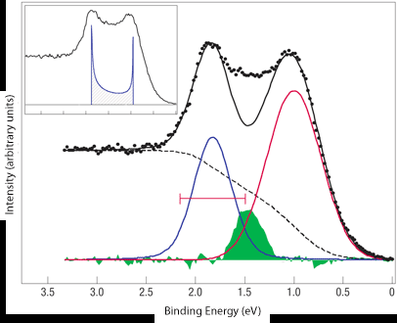
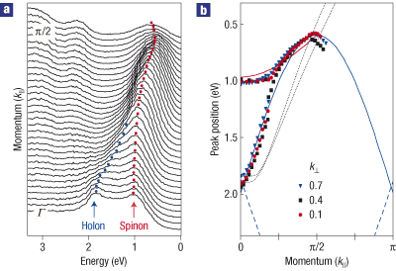
, "Distinct spinon and holon dispersions in photoemission spectral functions from one-dimensional SrCuO₂,"
B.J. Kim, H. Koh, E. Rotenberg, S.-J. Oh, H. Eisaki, N. Motoyama, S. Uchida, T. Tohyama, S. Maekawa, Z.-X. Shen, and C. Kim, Nature Physics 2, 397 (2006).
Angular resolved photelectron spectroscopy measurements
Spinon
Holon

Slide 21
Spinon and Holon Dispersion
The spinon hops two sites at a time so the period is basically 2a with a the lattice constant. The effective hoping integral is J (in actual fact it is J π/2) since this flips the appropriate spins to move the spinon. The holon moves with a hoping integral t. The spinons are fermions and the spinon band is half full to start with
πJ|sin(k−π/2)|/2 (|k| ≤ π/2) and the holon branch with 2t cos(k±π/2), respectively
The above is a formal theory of spinons in which they are considered as spin ½ particles added to the system qhen we remove an electron and with the antiferromagnetic ground state being a Fermi gas of spinons with the the Fermi level corresponding to half filling.
A poor mans way of describing the the spin change separation and spinon holon dispersion is as drawn above . Here the spinon lives on a lattice of period 2a and hops with hoping integral J and the holon lives on a lattice of lattice constant a and hops with a hoping integral t. This gives the same dispersion as above except for the factor of pi/2 for the spinon hopin.

Slide 22
The propagation of a hole in a two D antiferromagnetic background
A hole moves by hoping an electron into it from a
neighboring site conserving the spin. This movement leaves
a chain of wrongly oriented spins behind at a large energy cost.
Looks like a self confining potential is created. How can this be repaired?
Starting position of
A hole
Final position of
A hole

Slide 23
Try to repair with either the or with two holes moving together
the second hole following the first can repair the damage of the first if they are on neighboring sites creating an effective attractive interaction. The pair is now free to move!! Also less exchange bonds are broken if they are on nn sites.

Slide 24
A few remarks about magnetic ordering
In A NEEL ANTIFERROMAGNET AS DRAWN ABOVE THE SPINS ARE UP OR DOWN AND QUANTUM FLUCTUATIONS ARE ASSUMED TO BE ABSENT. THIS IS FAR FROM REALITY FOR A 1D SPIN ½ SYSTEM AND ALSO TO A LESSER DEGREE FOR A 2D SYSTEM WITH SPINS OF ½. In 1D long range order cannot exist and in 2D antiferromagnetic long range order can only exist at T=0. However both in 1D and 2D the antiferromagnetic correlations exist over a long range increasing in length as T decreases.
Tn of about 300K in the high tc superconducting parent compounds is not representative of the large J=140meV or about 1500K but is representative of the small interplaner coupling J’ times the spin spin correlation length build up in the planes due to J.

Slide 25
Resonant valence bond vs Neel
Energy of Classical antiferromagnetic Neel state
N = no of sites, Z= number of nearest neighbors,
and J = exchange between nearest neighbors
Energy of a nearest neighbor RVB singlet liquid state
Energy of a singlet is 3J/4
Singlet liquid RVB wins over long range order for Z <3. i.e. in 1D and perhaps perhaps in hole doped 2D system

Slide 26
Some interesting two particle problems
Recall we have an exact solution so have a look at some simple model molecules such as atoms in a triangle or square etc for U>> t and for two electrons or two holes and check for the singlet triplet splitting.

Slide 27
For U >>>t the two particles never see each other so is there a singlet triplet splitting?

Slide 28
Example of two particles in U=∞ limit
1
1
t
t
Triplet
2
2
2
1
±t
Singlet
Energy level diagram for holes (t>0)
2t
t
Singlet
Triplet
“+” for singlet; “-” for triplet
-t
-2t

Slide 29
Strong singlet triplet splitting as a result of symmetry
Singlet is lowest in energy for t<0 or for electrons
Triplet is lowest for t>0 or for holes
The energy splitting is determined by t the hoping integral not by some coulomb or exchange interaction
Potential for new magnetic materials without magnetic elements like the 3d transition metals of rare earths

Slide 30
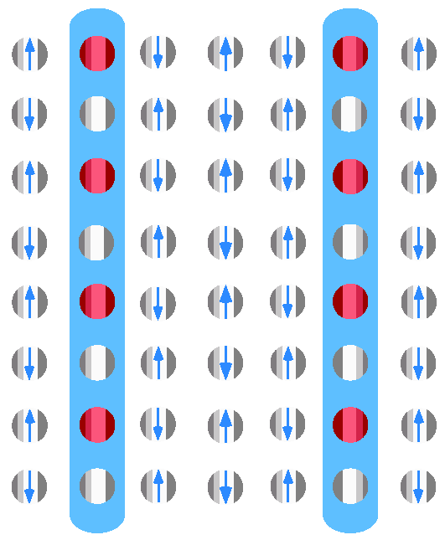
Similar is some sense to the 1D case it is proposed that for a 2D system with finite doping one has rivers of charge separating anti-phase antiferromagnetic domain walls. Also called electronic nematic ordering. Charges can now fluctuate from left to right without costing exchange energy.
Anisimov, Zaanen ,Andersen, Kivelson,Emery-----

Slide 31
Coulomb interactions in solids
How large is U ?
How are interactions screened in solids?

Slide 32
Do we need screening at all?
In the beginning we showed that we know the exact Hamiltonian and the exact equation we have to solve to understand the electronic structure of solids
Indeed if we could do this then no need for screening and effective parameters
Because we can’t solve the above we use models and it is in those models where not all interactions and states are included.
This requires us to include whatever is not included in a “renormalization “ of the parameters in the models.

Slide 33
For a Hubbard model for example
We have to include the effects of all the longer range coulomb interactions in an effective “U” and hoping integrals t
We have to include the effects of all the other states not included explicitly in H on U and t
Perhaps we have to add some longer range interactions like V=nearest neighbor coulomb and longer range hoping than nearest neighbor

Slide 34
How to include longer range and off diagonal interactions
Screening???
But what about the reduction of short range interactions?

Slide 35
Start with the conventional assumption of a uniform polarizable medium.

Slide 36
From Auger spectroscopy we know U is strongly reduced in the solid
How can U be reduced in the solid?
Surely we cannot use U=U0/Є with Є= dielectric constant? After all no “screening “ charge can get between the two electrons on the same atom.
We have to go back to the original definition of U in terms of ionization potential and electron affinity.
Lets first review conventional screening valid for long range interactions.

Slide 37
Homogeneous Maxwell Equations
ε(r,r’) —> ε(r – r’) —> ε(q)
Ok if polarizability is uniform
In most correlated electron systems and
molecular solids the polarizability is actually
Very NONUNIFORM

Slide 38
Review uniform polarizability approach
Maxwell
=screened potential
Poisson
Free electron gas in one,two and three dimensions
Response to a static (external like an impurity ) potential
Screening potential
Phonon softening and Giant Kohn anomaly

Slide 39
Electron density =n(r) =
Take a potential of the form
Free electron wave function and energy i.e. φ(r) =const

Slide 40
Perturbation theory approach
f’s are the occupation numbers and the sum is
over the possible excitations from below to above
the Fermi energy. Use Poisson to get the induced potential

Slide 41
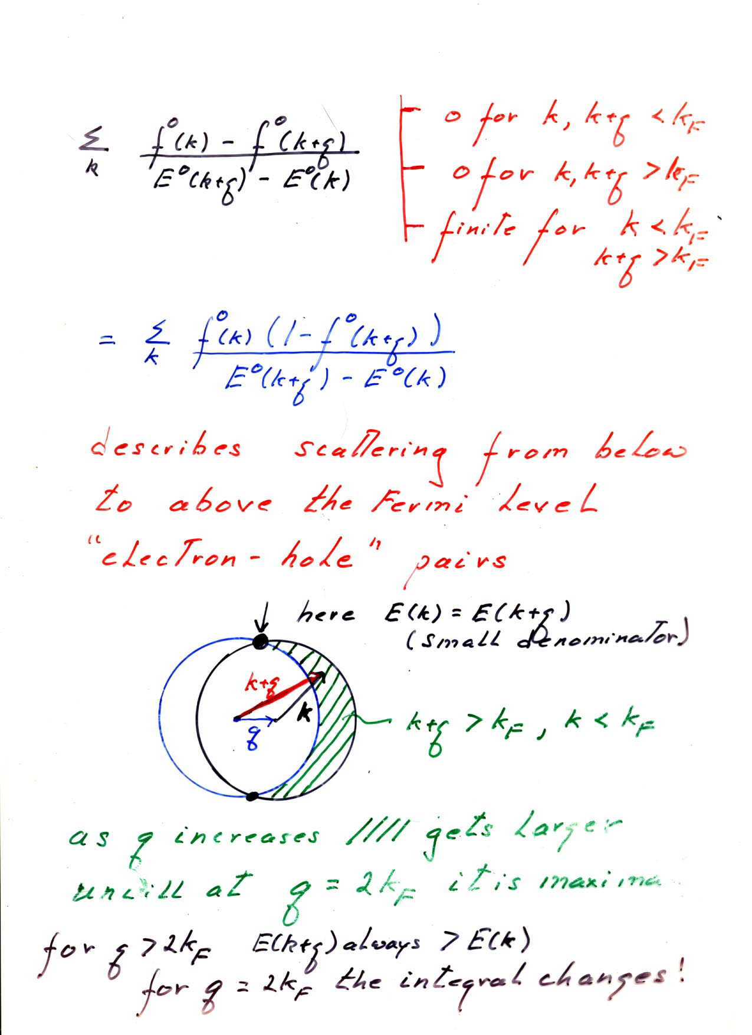

Slide 42
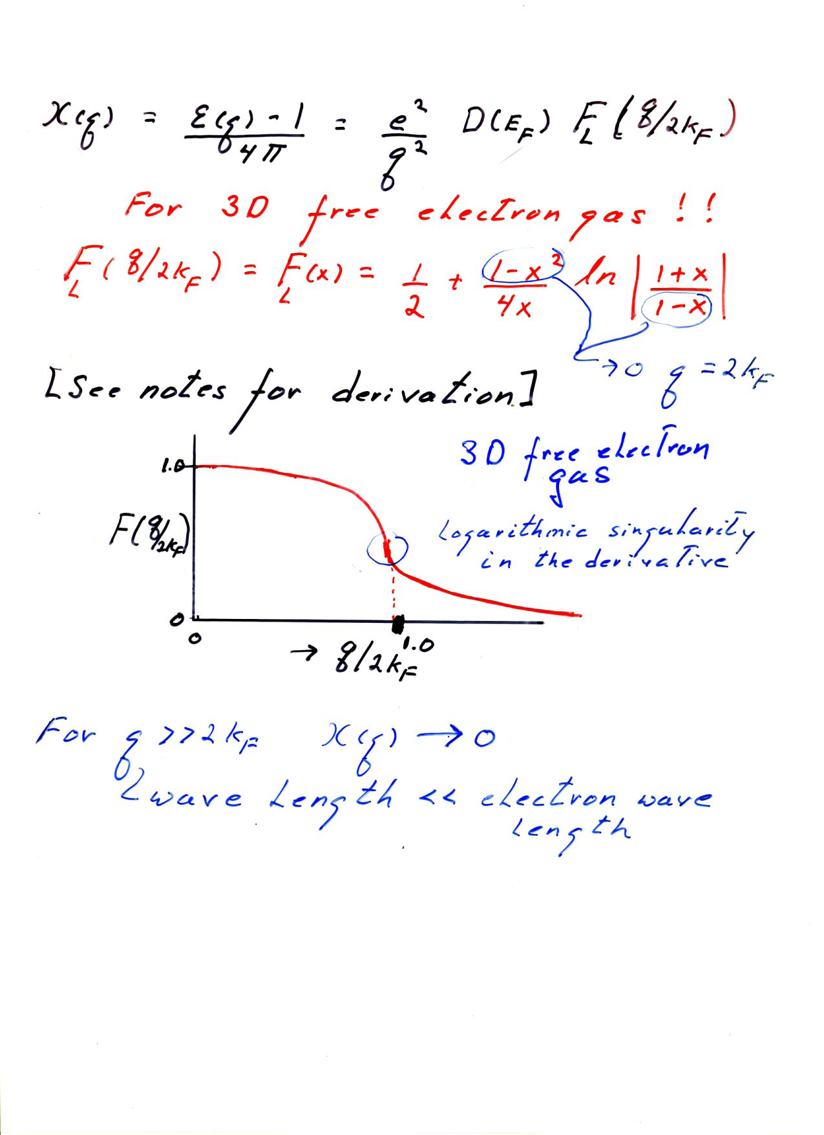

Slide 44
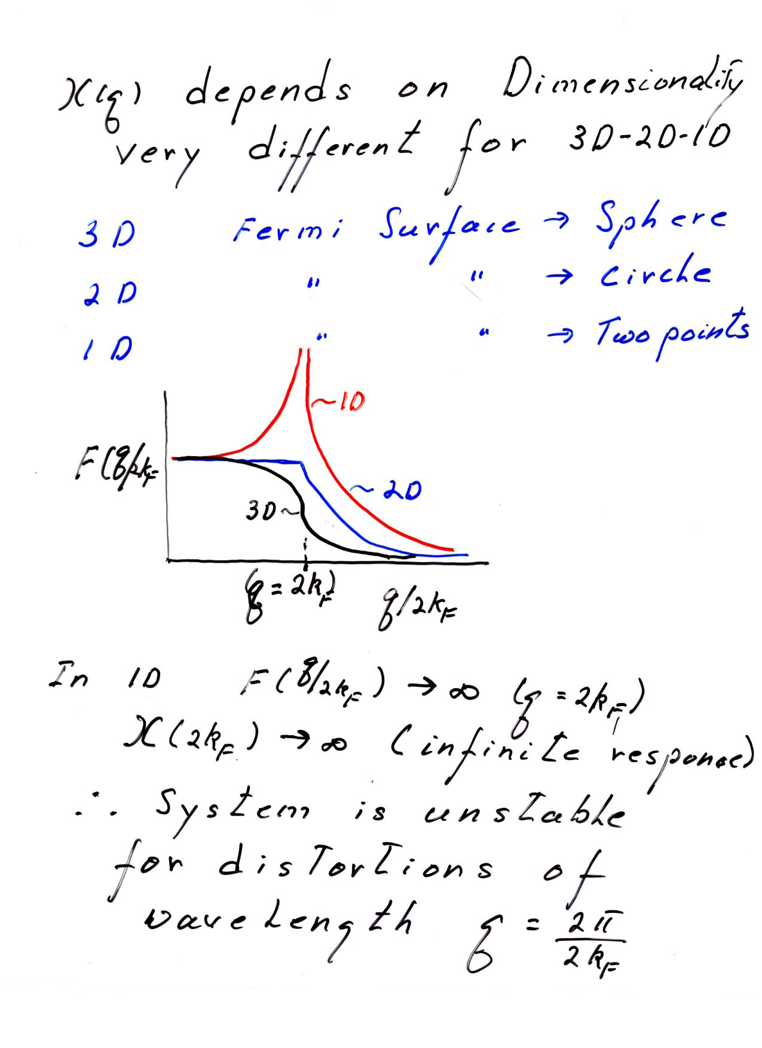

Slide 45
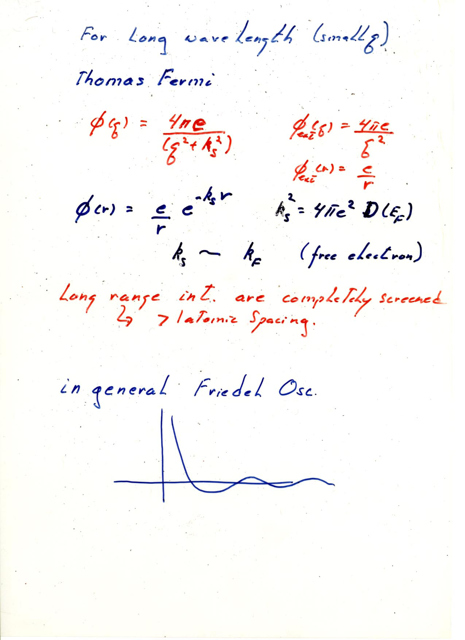

Slide 46
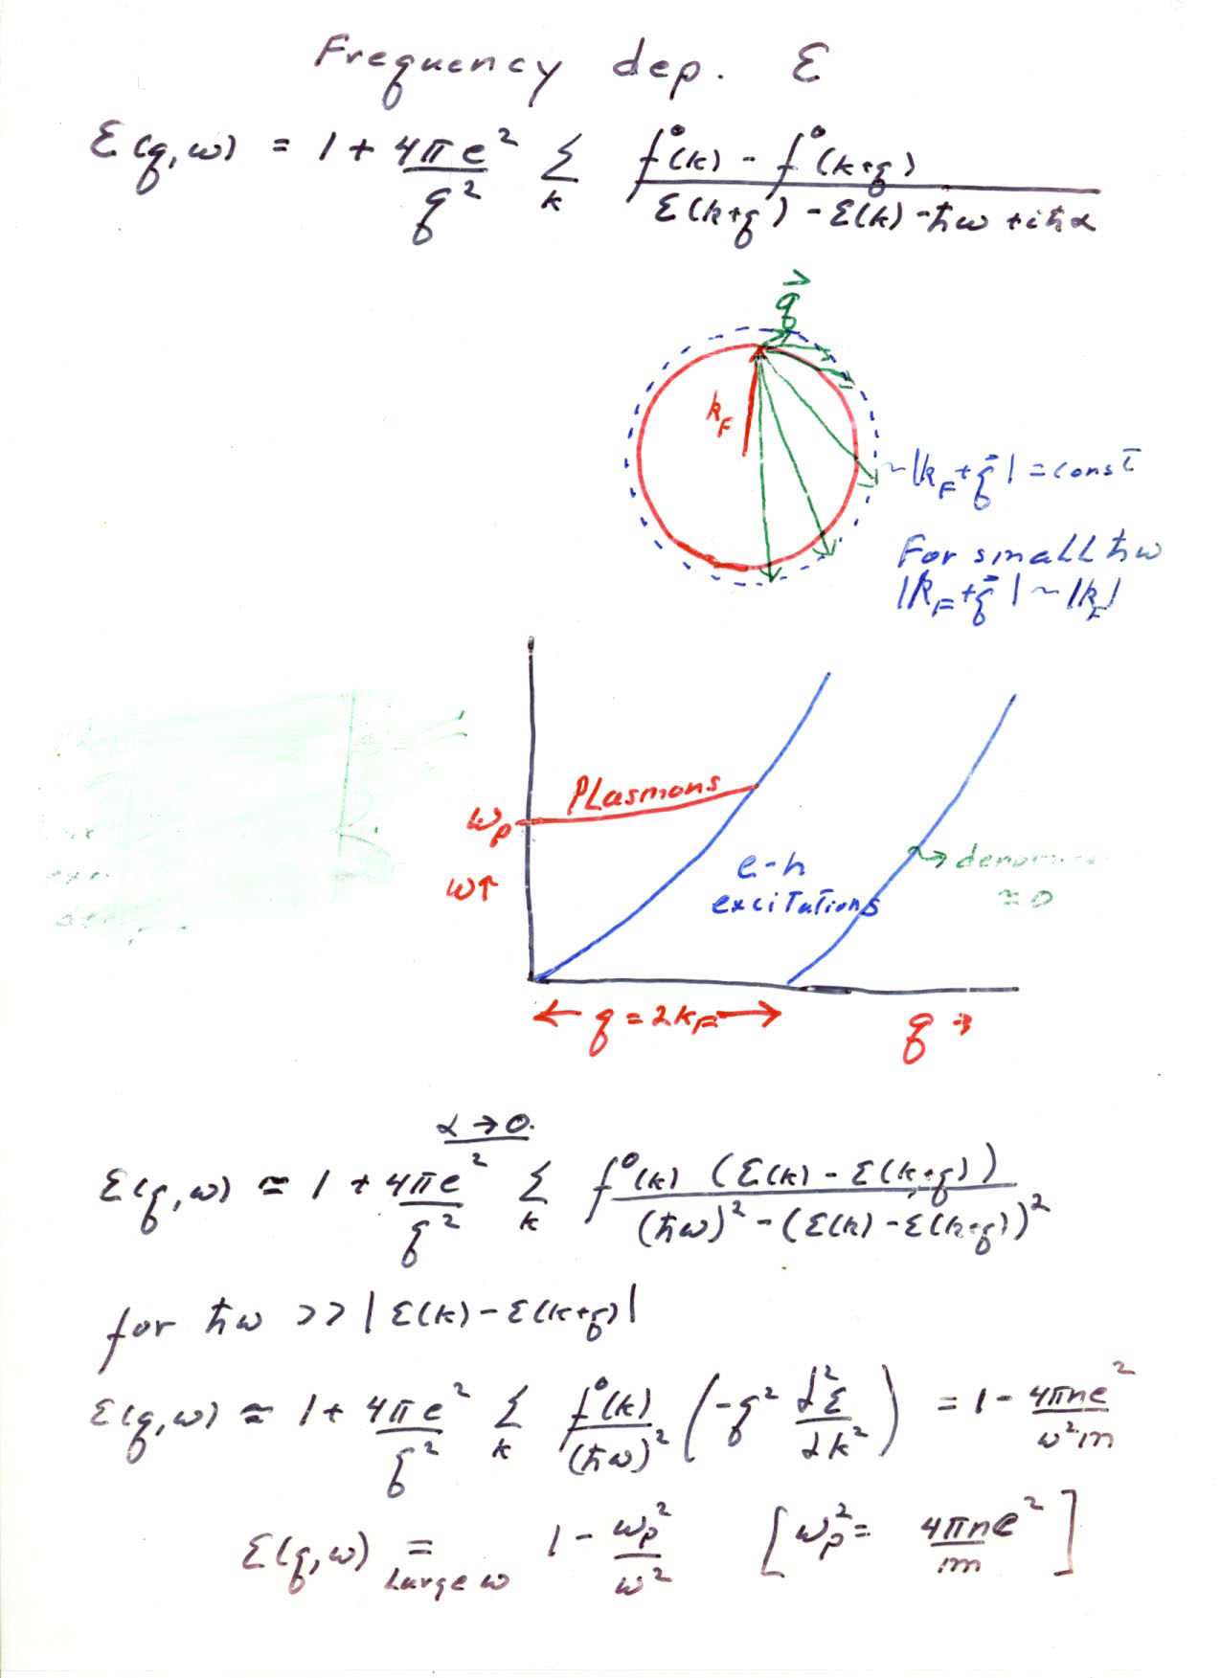

Slide 47
Consequences of the anomalous 2kf behaviour of the Lindhard function at
Friedel charge density Oscillations-RKKY Ruderman-Kittel-Kasuya-Yoshida long range exchange interactions in metals
Giant Kohn Anomaly---phonon softening for q=2kf
Fermi surface nesting in 2D
Semiconductor metal transition –Peierls transition both charge and spin Peierls

Slide 48
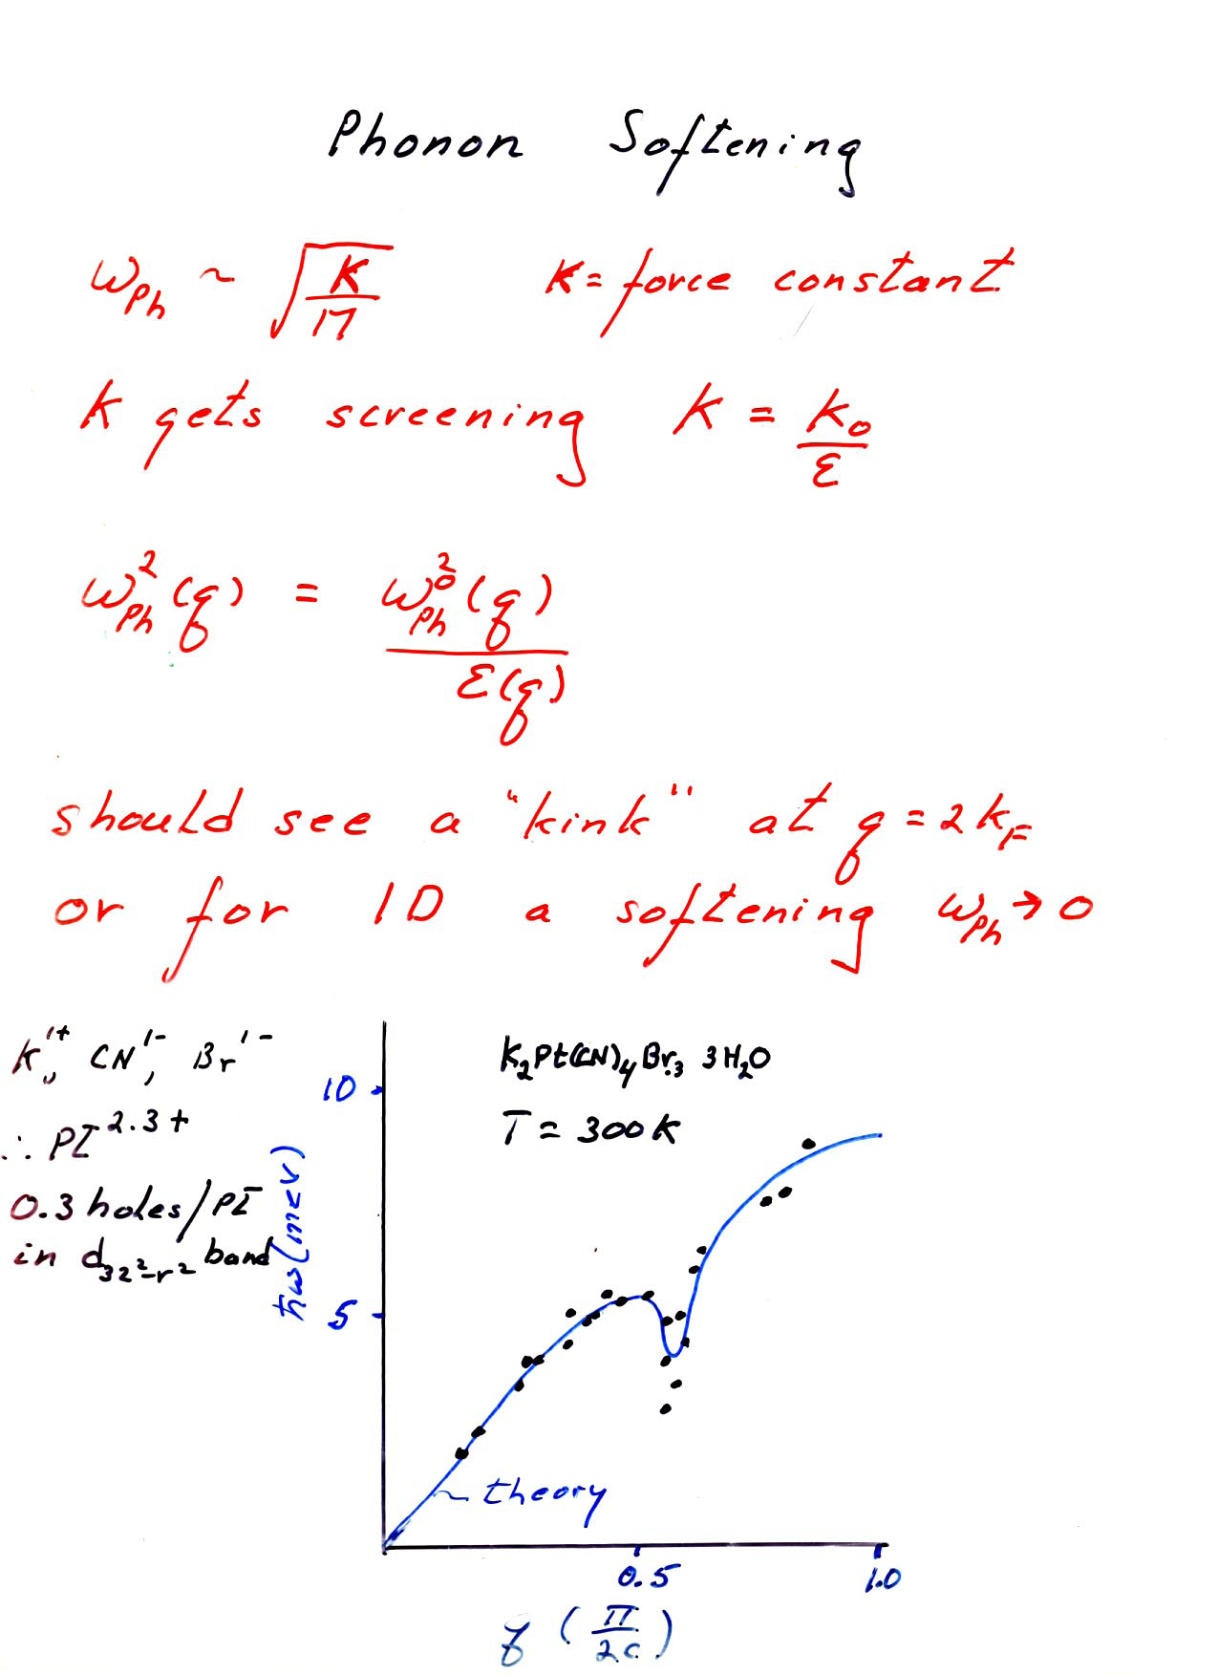

Slide 49
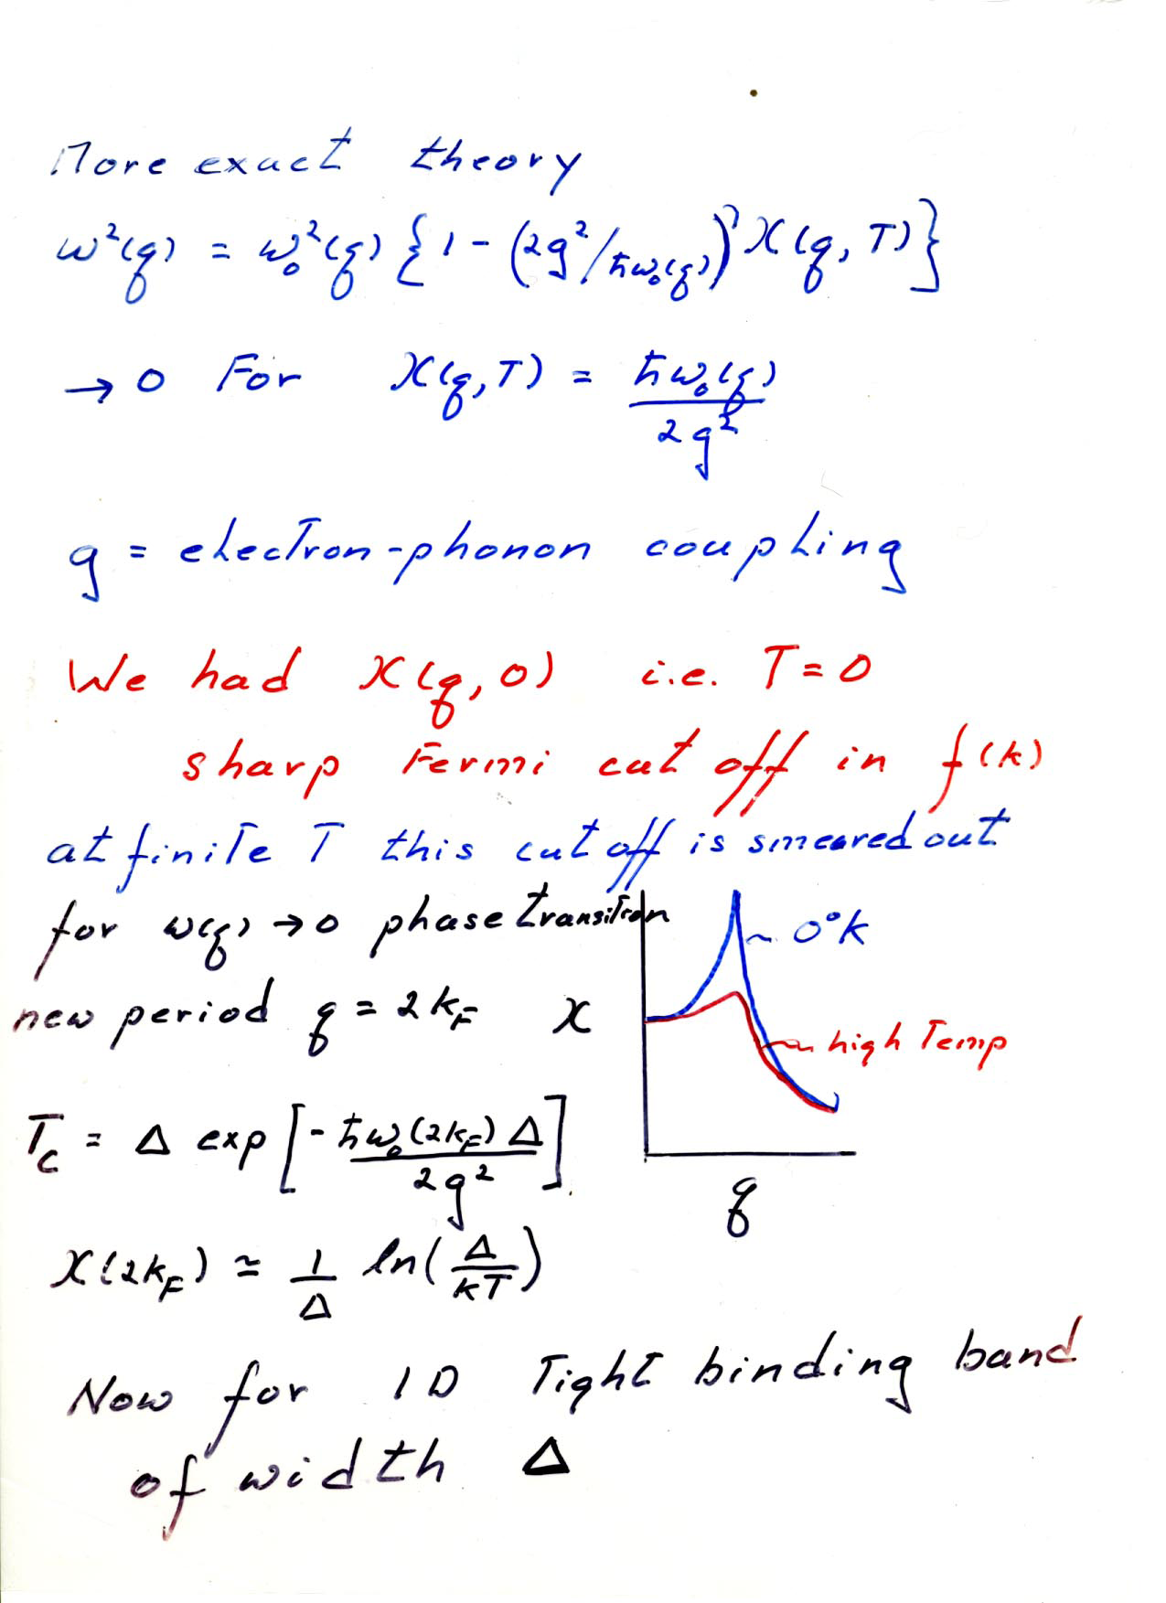

Slide 51
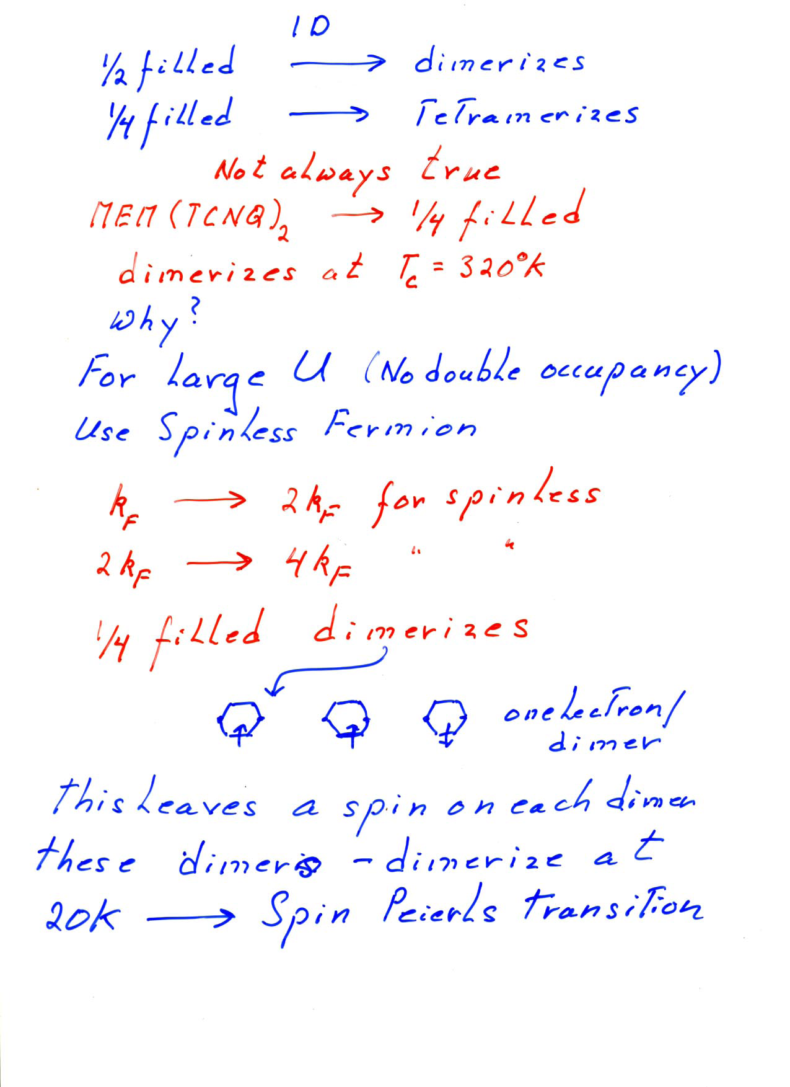

Slide 52
